Slide 1
Maintaining Bone Health
Senior Health, Vitamins, Minerals, and Osteoporosis
Darlene C. Taylor Kaplan University Unit 4 HW499: Capstone in Health and Wellness October 17, 2016
Notes:
INTRODUCTION: Hello, I am Darlene Taylor, your ACE- certified Wellness Coach. Today, I’d like to take a moment to talk with you about the effects of vitamins and minerals on bone heath. I know you are about 45 minutes away from lunch, so I’ll attempt to be brief but informative.
(Next Slide)

Slide 2
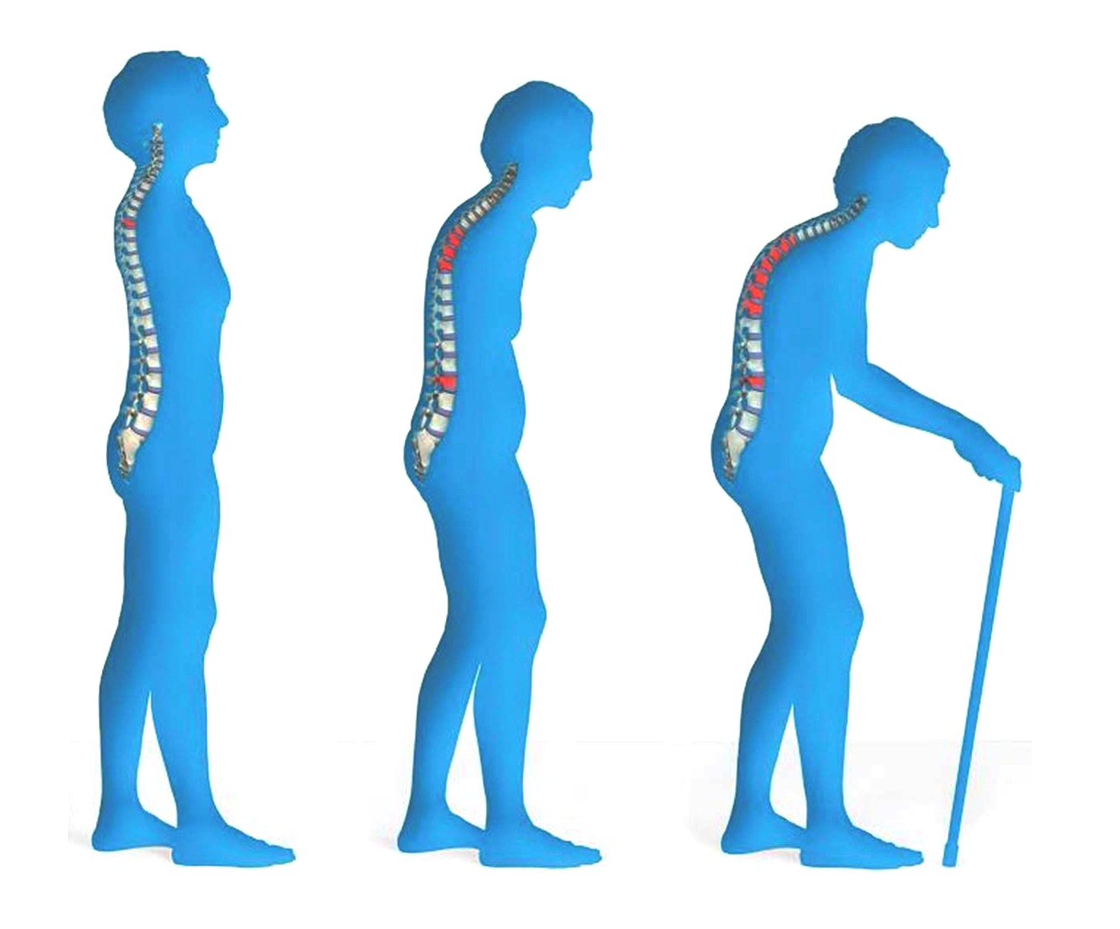
Notes:
This graphic and what it represents is all too common.
Does anyone know why this happens?
(Wait)
Is this a natural part of aging?
(Wait)
What I want you to know is that this is not necessary a natural part of aging. It the result of poor bone health.
Bone serve many vital function in the body. Not only do they serve as the framework for the body. They also protect our internal organs from injury, assist the body in movement, produce blood cells, and store vital minerals for the body to use when needed.
However, bones are constantly changing—evolving. And bone loss is a natural part of the aging process. However, the natural process of bone lose should not lead to osteoporosis.
So, let’s look at osteoporosis in more depth and way we may prevent it.
(Next Slide)

Slide 3
“Osteoporosis is a disease characterized by low bone mass and structural deterioration of bone tissue, leading to bone fragility and an increased risk of fractures of the hip, spine, and wrist. ” (NIH, 2015)
Notes:
Osteoporosis is a progressive disease. The word literally means “porous bones.” It is often called the “Silent Disease” because you can’t feel your bones getting weaker. You probably won’t know it has happened until it’s too late. Many people don’t know until they have a change in posture, or break a hip. Back pain could be one of the first signs.
The only way you can proactively determine if you have osteoporosis is by getting a bone density test, which measures how much bone you have in your hips and spine.
And what might the test find?
(Next slide)
Reference
NIH. (2015). Osteoporosis Overview. Retrieved from NIH: http://www.niams.nih.gov/Health_Info/Bone/Osteoporosis/overview.asp

Slide 4
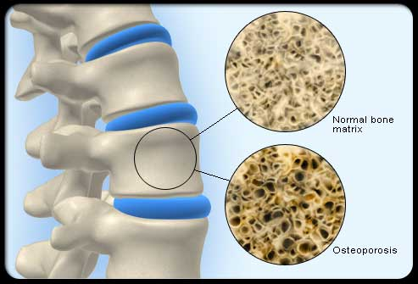
Notes:
The top cross section represents healthy bone.
Your bones are living, growing tissue that store calcium and other minerals. Healthy bone is a result of the body’s ability to form new bone quicker than it removes old bone. So, when we are young we form bone quicker, therefore, allowing for more bone mass. We reach maximum bone density and strength around the age of 30.
The bottom cross section is a snapshot of bone with osteoporosis. In this case, the removal of old bone exceeds formation of new bone.
The result is porous, brittle bones
(Next Slide)

Slide 5
Prevalence & the Facts
Over 10 million Americans have osteoporosis
½ of women 50 and older will have an osteoporosis-related fracture in their lifetime
Notes:
According to the International Osteoporosis Foundation (n.d.):
The 44 million people with either osteoporosis or low bone mass represent 55 percent of the people aged 50 and older in the United States.
By the year 2010, it is estimated that more than 52 million women and men in this same age category will be affected and, if current trends continue, the figure will climb to more than 61 million by 2020.
In 2002, it is estimated that more than 10 million people already have osteoporosis. Approximately eighty percent of these people are women. This figure will rise to almost 12 million individuals by 2010 and to approximately 14 million by 2020 if additional efforts are not made to stem this disease, which may be largely prevented with lifestyle considerations and treatment when appropriate.
Reference:
IOF. (n.d.). Facts and Statistics. Retrieved from The International Osteoporosis Foundation: https://www.iofbonehealth.org/facts-statistics#category-23

Slide 6
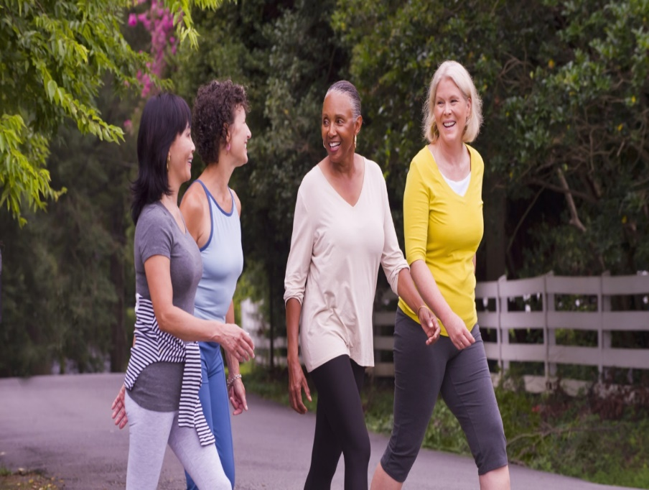
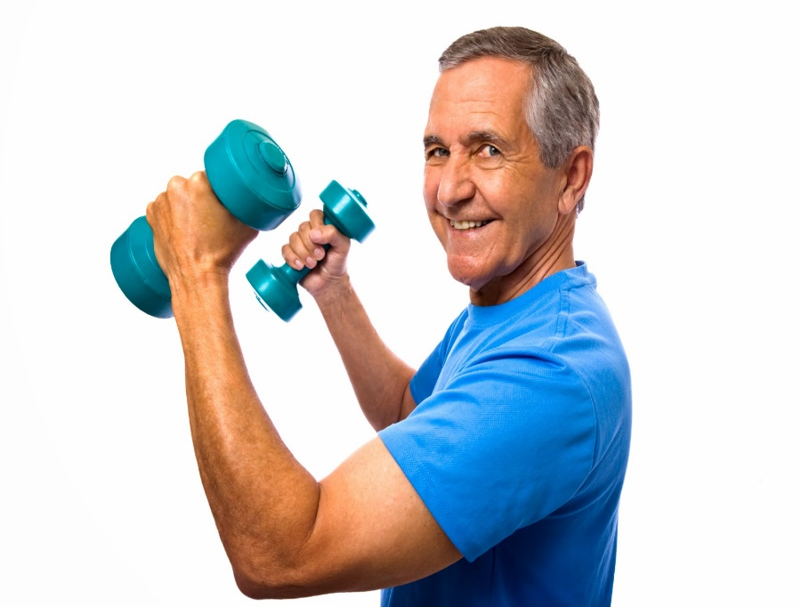
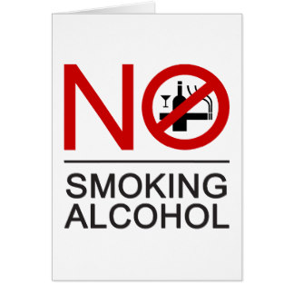
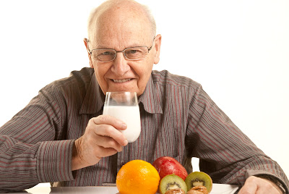
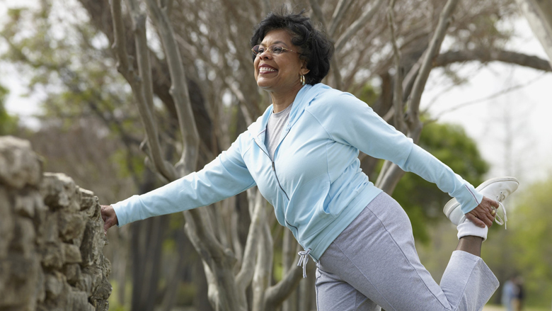
Risk Factors
Gender
Age
Race/Genetics
Hormone levels
Physical Inactivity
Smoking
Medications
Poor Diet
Notes:
According the National Institute of Health, there are many risk factor associated with osteoporosis.
Uncontrollable factors include gender, age, race, family history and hormone levels. Let’s take a more in-depth look at each one.
Gender: Both men and women can develop osteoporosis; however, 80% of people with osteoporosis are women. Women’s bones are smaller and thinner than men’s.
Age: As discussed, as we age our bones naturally become thinner and weaker.
Race/Genetics: Research has shown that Caucasians and Asians are more prone to develop osteoporosis. Estimates reveal that 20% of Asian and Caucasian women over 50 years of age have osteoporosis, while only 10% of Hispanic and 5% of non-Hispanic black women have the disease.
Hormone levels: Research reveals that low level of estrogen in women and low testosterone in men can result in a loss of bone mass. Therefore, post-menopausal women or women with amenorrhea are at higher risk of developing osteoporosis.
The bold risk factor represent those that are controllable.
Physical inactivity: Being inactive increases one’s risk of osteoporosis. The fact is living a sedentary lifestyle can lead to many diseases to include cardiovascular diseases, diabetes, or obesity. In relation to osteoporosis, if you don’t move, your bones become weak. Exercise can help slow bone loss and can also build or maintain muscles. Try to exercise for 30 minutes most days. Look for opportunities to move throughout your day. Strength training can also help strengthen bone, so it is recommend XXXXX. Walking, jogging, hiking, climbing, aerobics, tennis, and weight training are good options for most people. But check with your doctor first.
Smoking: Research has shown a direct correlation between smoking and bone density. The NIH says the best thing you can do is quit.
Medications: Medicine to treat thyroid disease, endometriosis, and some cancers also decrease bone mass. Therefore, talk to your provider and inquire about the impact of your prescription drugs on your bone health.
Poor Diet: Consuming a diet with inadequate amounts of calcium increase your risk of osteoporosis. However, it is much more complex than that. Vitamin D, potassium and magnesium also play a vital role, which we’ll discuss in more detail in the following slides.
(Next Slide)
Reference
NIH. (n.d.). Risk Factors. Retrieved from NIH Senior Health: https://nihseniorhealth.gov/osteoporosis/riskfactors/01.html
McCoy, K. (n.d.). Osteoporosis Across Cultures. Retrieved from Everyday Health: http://www.everydayhealth.com/osteoporosis/osteoporosis-across-cultures.aspx
Sampson, H. W. (2003, Jun). Alcohol and Other Factors Affecting Osteoporosis Risk in Women. Retrieved from NIH: http://pubs.niaaa.nih.gov/publications/arh26-4/292-298.htm

Slide 7
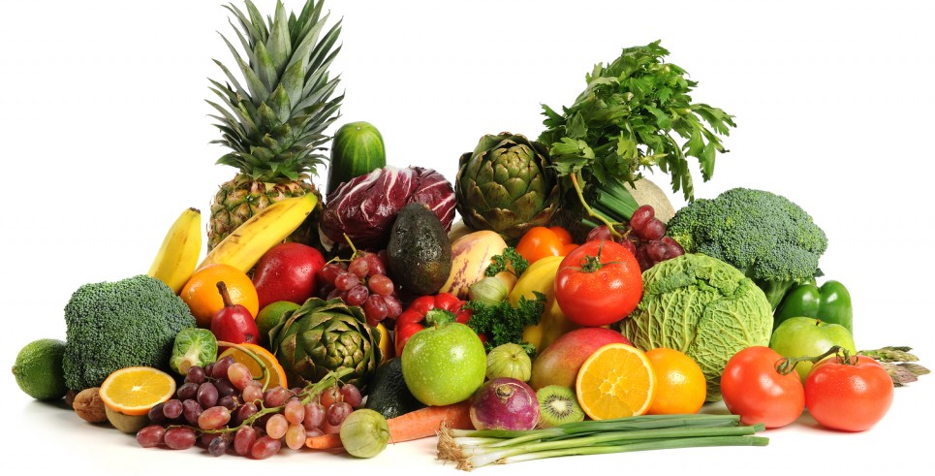
Minerals Needed for Bone Health
Calcium
Potassium
Magnesium
Notes:
Your body needs calcium to function. When it doesn’t have enough, it pulls calcium from your bones. Not getting enough calcium can lead to bone thinning and raises your chance of fractures. 99% of calcium is found in bones and the remaining 1% is found in the cells and fluids for
muscle contraction
release of neurotransmitter
blood pressure regulation
Most adults need at least 1,000 mg of calcium a day. Sources of calcium include: cheese, yogurt, milk, sardines, dark leafy greens like spinach, kale, turnips, and collard greens, fortified cereals, fortified orange juice, soybeans, and enriched breads, grains, and waffles.
-----------------------
Web MD states that, “two lesser known nutrients that help keep bones healthy are magnesium and potassium. “
If you’re low on magnesium, you can have problems with your vitamin D balance, which may affect your bone health. Most adults need at least 400 mg of magnesium. Sources include sweet potatoes, kelp, wheat germ, garbanzo beans, oysters, spinach, almonds, cashews, cocoa, and water.
Potassium neutralizes acid in your body that can leach calcium out of your bones. Most adults need at least 4,700 mg of potassium. Sources include white beans, dark leafy greens, baked potatoes, dried apricots, yogurt, fish, avocados, mushrooms and bananas.
---------------------
Reference:
NIH. (2016, Jun). Calcium. Retrieved from NIH: https://ods.od.nih.gov/factsheets/Calcium-Consumer/
WebMd. (n.d.). 11 Unexpected Foods That Are Good for Your Bones. Retrieved from WebMD: http://www.webmd.com/osteoporosis/ss/slideshow-superfoods-for-your-bones
WebMD. (n.d.). How much magnesium should you take daily? Retrieved from Google Search: http://www.bing.com/search?q=how+much+magnesium+should+you+take+daily&form=IE10TR&src=IE10TR&pc=EUPP_MASAJS

Slide 8
Vitamin D for Bone Health
The “Sunshine” vitamin
Can be made in the body or by the skin when exposed to sunlight
Needed to maintain normal levels of calcium in the body
Notes:
Vitamin D, which you can get from the sun and from food, is important to bone health. Your body can’t absorb calcium without it. Older adults between 50-70 years of age need least 400 IUs day. According to the NIH, “Very few foods in nature contain Vitamin D. The flesh of fatty fish (such as salmon, tuna, and mackerel) and fish liver oils are among the best sources. Small amounts of Vitamin D are found in beef liver, cheese, and egg yolks. Fortified foods provide most of the Vitamin D in American diet.” With that, one of the best source of Vitamin D is exposure to ultra violet rays.
Your doctor can help you know if you’re getting enough vitamin D.

Slide 9
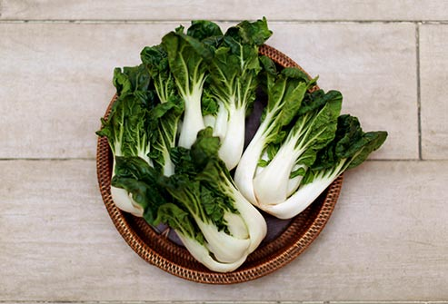
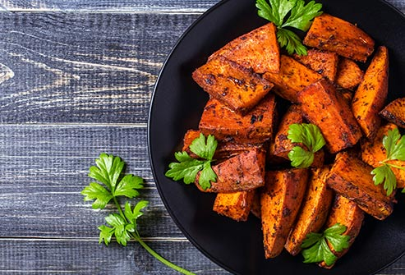
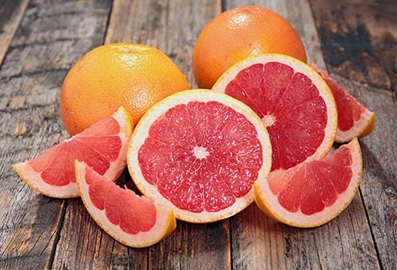
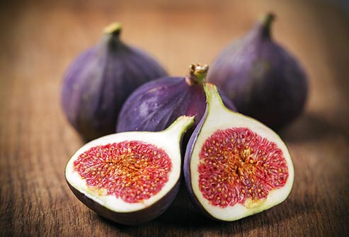
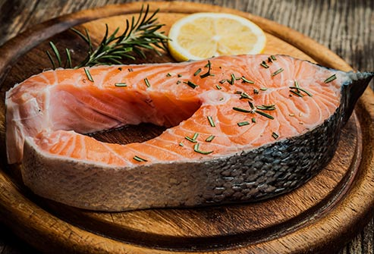
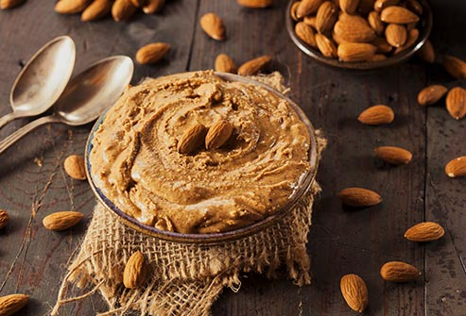
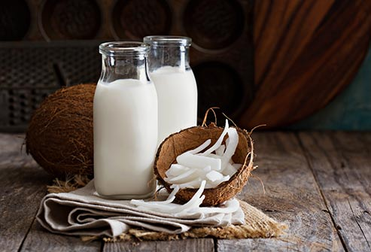
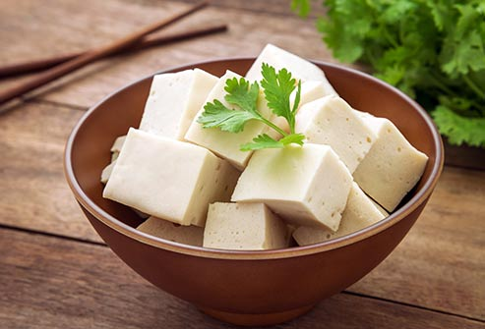
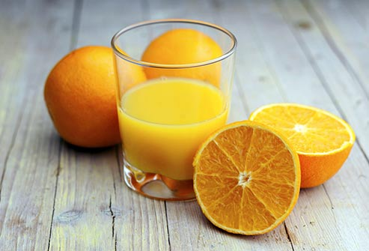
1
2
3
4
5
6
7
8
9
Notes:
This is a graphic representation of bone healthy food. The information and photos was were retrieved from MaryAnn Tomovich’s slide presentation entitled “11 Unexpected Foods That Are Good for Your Bones” Retrieved from http://www.webmd.com/osteoporosis/ss/slideshow-superfoods-for-your-bones
Let’s talk about each one and what vitamin or mineral they contain.
Dark, leafy greens. Calcium
Sweet potatoes. Magnesium and Potassium
Citrus fruits. Vitamin C
4. Figs. Calcium, Magnesium and Potassium
Fatty fish (salmon). They contain vitamin D, which helps your body use calcium, and omega-3 fatty acids, which may also aid bones.
Almond butter. Calcium and Potassium
Milks” from plants. Almond, and coconut milk normally has added calcium and vitamin D
Tofu. Calcium
They all look so good, I’m getting hungry. Anyone else, ready for lunch? We are almost done and I’ll let you get to your lunch.

Slide 10
Post Test
True or False. You can feel your bones getting weaker.
Your body needs Vitamin _ to absorb calcium?
True or False. You body takes calcium from your bones when you don’t get enough.
Your bones starts to thin at what age?
True or False. If you’re over 50, exercising won’t help your bone health.
Who is most likely to get osteoporosis?
What is the best exercise for your bones?
True or False. If your mother has osteoporosis, you might too.
Notes:
So, now that we’ve discussed osteoporosis and bone health for the last 20 minutes, let’s take a belief quiz.
(Hand out paper and ask the questions)
(Once complete, review the test)
False
Vitamin D
Mid 30s
False
Caucasian and Asian Women
Walking
True
(Next slide)

Slide 11
Questions?
Notes:
Do I have any questions? (Answer any questions)
In closing, thank you for taking a moment to listen to me. In summary, we’ve talked about the importance of bone health. As we age, maintaining healthy bones requires you to eat right and exercise regularly to avoid osteoporosis. I encourage any of you who have a concern about the current state of you bones to consult with your physician.
Thank you once again.

Slide 12
References (1 of 2)
IOF. (n.d.). Facts and Statistics. Retrieved from The International Osteoporosis Foundation: https://www.iofbonehealth.org/facts-statistics#category-23
McCoy, K. (n.d.). Osteoporosis Across Cultures. Retrieved from Everyday Health: http://www.everydayhealth.com/osteoporosis/osteoporosis-across-cultures.aspx
NIH. (2015). Osteoporosis Overview. Retrieved from NIH: http://www.niams.nih.gov/Health_Info/Bone/Osteoporosis/overview.asp
NIH. (2016, Jun). Calcium. Retrieved from NIH: https://ods.od.nih.gov/factsheets/Calcium-Consumer/
NIH. (n.d.). Risk Factors. Retrieved from NIH Senior Health: https://nihseniorhealth.gov/osteoporosis/riskfactors/01.html
Sampson, H. W. (2003, Jun). Alcohol and Other Factors Affecting Osteoporosis Risk in Women. Retrieved from NIH: http://pubs.niaaa.nih.gov/publications/arh26-4/292-298.htm
WebMd. (n.d.). 11 Unexpected Foods That Are Good for Your Bones. Retrieved from WebMD: http://www.webmd.com/osteoporosis/ss/slideshow-superfoods-for-your-bones
WebMD. (n.d.). How much magnesium should you take daily? Retrieved from Google Search: http://www.bing.com/search?q=how+much+magnesium+should+you+take+daily&form=IE10TR&src=IE10TR&pc=EUPP_MASAJS

Slide 13
References (2 of 2)
Graphics
Slide 2: http://www.dentistryiq.com/content/dam/diq/online-articles/2013/05/osteoporosis-fo.jpg
Slide 4: http://www.dentistryiq.com/content/dam/diq/online-articles/2013/05/osteoporosis-fo.jpg
Slide 6: http://www.healthyeating.org/Portals/0/Gallery/Album/Healthy%20Eating/senior%20couple%20stretching%20small.jpg
http://www.bing.com/images/search?q=Healthy+Older+Adults+walking&view=detailv2&&id=E5F4EB45176E2338EAAF4372F478E591AC974808&selectedIndex=4&ccid=3eZ2dUfr&simid=608046114789982979&thid=OIP.Mdde6767547eb24d6bc836f30f460a93bH0&ajaxhist=0
http://3.bp.blogspot.com/-XwwJXQTc4hM/T6IvRUlWlyI/AAAAAAAAAHI/4hVyQ7OUOKc/s400/What-Old-People-Should-Eat.jpg
http://rlv.zcache.co.nz/no_smoking_alcohol_thai_sign_card-ra014ef69ab0947f8b313536962437421_xvuat_8byvr_324.jpg
http://4.bp.blogspot.com/-8sTxkbcYO9U/UwmfgkYLneI/AAAAAAAABfc/WT7IVDVbTSQ/s1600/Exercises-for-older-adults.jpg
Slide 7: http://strong-athlete.com/wp-content/uploads/2013/01/VitaminsMinerals-1024x682.jpg
Slide 8: http://4.bp.blogspot.com/-F2J6N2QCgaY/UcLFvYYOAwI/AAAAAAAAJa0/wQsnQKKWEHQ/s1600/yellow-sun-white-hi.png
Slide 9: http://www.webmd.com/osteoporosis/ss/slideshow-superfoods-for-your-bones

